Slide 1
Lesson 04 Cross Product of Vectors
Interactive Seminar Slides
E114 – Mathematics for Engineering

Slide 2
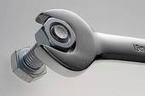
Scenario
A torque wrench is a tool used to precisely apply a specific torque to a fastener such as a bolt or screw. It was designed so as not to over-tighten bolts on pipes. One can measure the torque applied to the fastener so it can match the specifications for any particular application.
When a bolt is loosened by applying a force to a wrench, the torque that is produced acts along the axis of the bolt to drive the bolt forward. The magnitude of the torque depends on how far out on the wrench the force is applied and on how much of the force is perpendicular to the wrench. The torque (relative to the origin) is defined as the cross product of the position and force vectors,
Suppose that a bolt is loosened by applying a 30 N force to a 0.3 m wrench as shown in the figure below. Find the magnitude of the torque about the center of the bolt.

Slide 3
Scenario Definition Template
What do we know?
The definitions of torque, force and displacement.
The mechanism of using a torque wrench to loosen a bolt.
The cross product of the position and force vectors is given.
What do we not know?
The method of calculation given the mathematical relationship between the torque ,force and displacement.
The direction of all these vectors.
What do we need to find out?
The magnitude of the torque about the centre of the bolt while applying the given force at the given displacement from the centre of the bolt.
What is cross product of 2 vectors?

Slide 4
Lesson Overview
S/N | Concepts | Slide Number
1 | Cross product | 5-9
2 | Area of parallelogram | 10-12
3 | Properties of Cross Product | 13
4 | Orthogonality using the Cross Product | 15-17
5 | Normal Vector to a plane | 18-22
6 | Equation of a plane | 23-25
7 | Volume of the parallelepiped | 26-27
8 | Coplanarity (CL) | 28-31

Slide 5
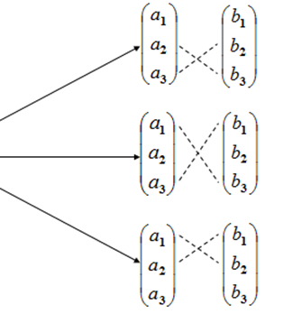
Cross Product
If and , then the cross product of and is the vector
Note that
is defined only when and are 3-D vectors
is a scalar quantity while is a vector quantity!

Slide 6
Finding the Cross Product
If and , find the cross product of and .
[Example]
[Solution]

Slide 7

Test Yourself (1)
If and ,
i) Determine .
ii) Determine .

Slide 8
Magnitude of Cross Product
The magnitude of the cross product of two vectors can be evaluated as
where θ is the angle between and .

Slide 9
Magnitude of Cross Product
[Example]
[Solution]
Let us consider the exercise (slide 7) that you had already completed:
, and
Can you find the acute angle between and ?
Note: There are 2 possible angles using this sine formula, we need to use the scalar product to determine whether the angle between the vectors is acute or obtuse.

Slide 10
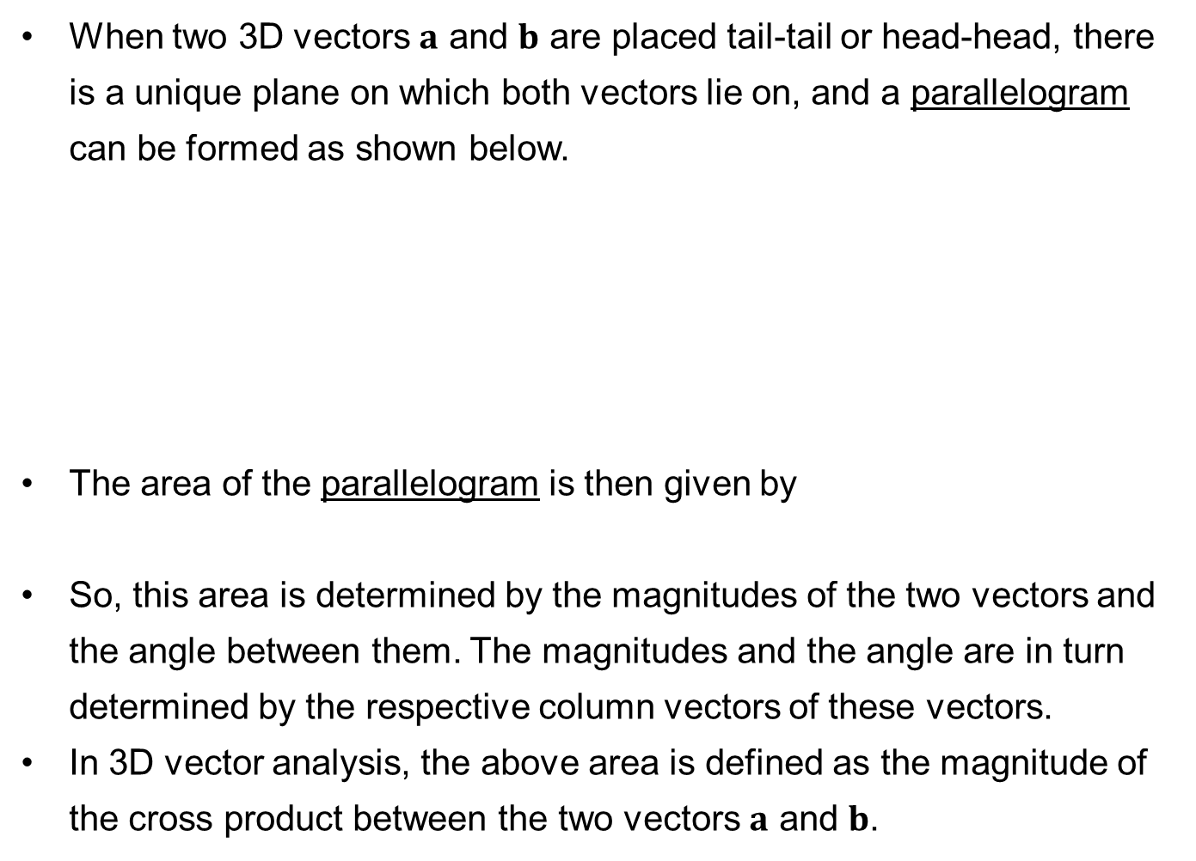


Parallelogram Formed by Two Vectors
When two 3D vectors $a$ and $b$ are placed tail-tail or head-head, there is a unique plane on which both vectors lie on, and a parallelogram can be formed as shown below.
The area of the parallelogram is then given by
So, this area is determined by the magnitudes of the two vectors and the angle between them. The magnitudes and the angle are in turn determined by the respective column vectors of these vectors.
In 3D vector analysis, the above area is defined as the magnitude of the cross product between the two vectors $a$ and $b$.
$$a$$
θ
$$b$$

Slide 11


Area of Parallelogram
[Example]
[Solution]
Find the area of the parallelogram with vertices P(1, 0, 2), Q(2, 2, 2) and R(1, 0, 3) with sides PQ and PR.
Area of parallelogram = 2.24 units²
$$R$$
$$P$$
Q

Slide 12
(Kahoot.IT) Think-Pair-Share
Find the area of the triangle with vertices P(0, 0, 0), Q(1, 2, 1)
and R(1, 0, 3)
Notes:
https://kahoot.it/

Slide 13
Properties of the Cross Product
If , and are vectors and k is a scalar, then
1.
2.
3.
4.
Note:
If , and are vectors then .

Slide 14
BRAIN BREAK
The greatest mistake
you can make in life
is to be continually fearing
you will make a mistake.
-- Elbert Hubbard

Slide 15
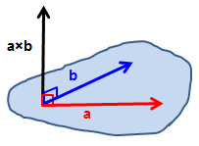
Orthogonality Using the Cross Product
For two vectors and ,
the scalar product produces a scalar
the cross product produces a vector
One of the most important properties of the cross product is:
The vector is orthogonal (perpendicular) to both and .

Slide 16
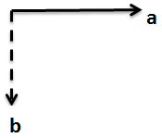
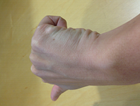
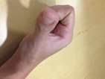
Direction of the Cross Product
The direction of is given by the right-hand thumb rule: if the fingers of your right hand curl in the direction of a rotation (through an angle less than 180°) from to , then your thumb points in the direction of .
Thumb points into the screen
Thumb points out of the screen

Slide 17
(Kahoot.IT) Poll
Given that the following vectors lie on the plane of the screen, determine whether each of the cross products are pointing into or out of the plane of the screen.
s
a
p
b
q
r
(A)
(B)
(C)
Notes:
https://kahoot.it/

Slide 18
Normal Vector to a plane
A plane is defined as a flat two-dimensional surface.
It has no boundaries (i.e. all sides can be extended infinitely)
A plane can be uniquely defined by
At least 3 distinct points lying on the plane or
At least 2 non-parallel vectors and 1 point, all lying on the plane
A normal vector to a plane is a vector that is perpendicular to every vector on that plane, that is, .
n
v

Slide 19
Normal Vector to a plane
A plane is known to have a normal vector and contains a point A as indicated in the diagram below. Determine whether points B (2, 6, 3) and C (0, 7, 5) lie on the plane.
Approach:
Form vectors and
Check whether and are zero
[Example]
[Solution]

Slide 20
Normal Vector to a plane
[Solution] continued
Since , is perpendicular to and hence, B lies on the plane.
Since , is not perpendicular to and hence, C does not lie on the plane.

Slide 21
Test yourself (2)
If a plane contains the points P (1, 0, 0), Q (1, 1, 1), and R (2, −1, 3), find a vector that is normal to the plane.
(Hint: First find and and then their cross product)

Slide 22
Test yourself (3)
If plane P has a normal vector , determine if vector is parallel to the plane.

Slide 23
Equation of a plane
Let X (x, y, z) be any point on a plane that contains a point A (a, b, c).
Then the vector is any vector on the same plane.
If the vector is a normal vector to the plane, we can find the
equation of the plane by using scalar product and the fact that any vector on the plane is perpendicular to the normal vector.
Any combination of (x, y, z) that satisfies the equation is a point on the plane.

Slide 24
Equation of a plane
Find the equation of the plane from the earlier example and check whether points B and C lie on the plane.
Check if B (2, 6, 3) is on the plane:
Sub coordinates into the equation.
B lies on the plane
Check if C (0, 7, 5) is on the plane:
C does not lie on the plane
[Example]
[Solution]

Slide 25
Test yourself (4)
The vector is normal to a plane that passes through the point
A (0, 1, 1). Find the equation of the plane.

Slide 26
Volume of Parallelepiped
A parallelepiped is formed by six parallelograms. Its volume can be calculated by using the three vectors , and of its edges.
The product is called the scalar triple product of the vectors ,
and .
Use Scalar Projection
a
c
b

Slide 27
Volume of Parallelepiped
Find the volume of the parallelepiped formed by the vectors
, and
The volume of the parallelepiped is
Volume of parallelepiped 23 units³
[Example]
[Solution]

Slide 28
Coplanarity (CL)
One of the most important aspects of cross products is that if the volume of the parallelepiped , then the three vectors , and are coplanar, lying on the same plane.

Slide 29
Coplanarity (CL)
Use the scalar triple product to show that the four points A, B, C and D are coplanar: A (4,-3,-2), B (11,-8,-5), C (-3,2,1) and D (1,3,2).
Form 3 vectors:
[Example]
[Solution]

Slide 30
Worked Example: Coplanarity (CL)
[Solution] continued
The cross product of is
Next, we find the volume, which is the magnitude of
Volume
Hence the points are coplanar.

Slide 31
Think-Pair-Share (CL)
Use the scalar triple product to show that the following vectors are coplanar:
, and .

Slide 32
One-minute write
Please stop what you are doing and produce a written response to either of the following in only one minute:
Identify what is the key learning concepts from the seminar, or
Write down a question with respect to the concepts learnt so far.
Link:

Slide 33
Learning Objectives
Perform cross product operations for 3-dimensional vectors.
Perform and interpret that the cross product of a vector onto another produces a vector that is perpendicular to both input vectors.
Determine the equation of a plane given two or more vectors or three or more points lying on the plane.
Apply cross product operations to
Obtain the area of a parallelogram with two given sides in vector form,
Obtain the volume of a parallelepiped with three given sides in vector form, and
Determine whether four or more points are coplanar.

